Slide 1
Network Layer Design Issues
Store-and-Forward Packet Switching
Services Provided to the Transport Layer
Implementation of Connectionless Service
Implementation of Connection-Oriented Service
Comparison of Virtual-Circuit and Datagram Subnets

Slide 2
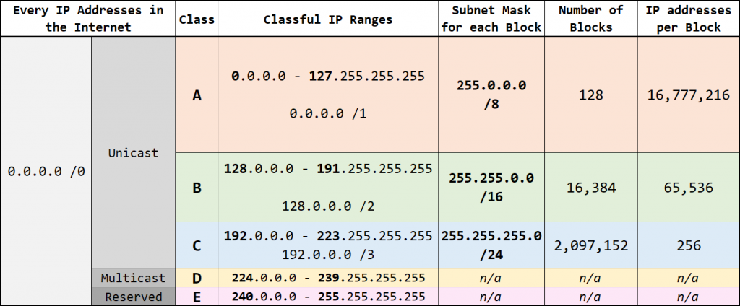


Slide 3

Store-and-Forward Packet Switching
The environment of the network layer protocols.
fig 5-1

Slide 4
Services provided to Transport layer
The services need to be carefully designed with the following goals in mind:
1. The services should be independent of the router technology.
2. The transport layer should be shielded from the number, type, and topology of the routers present.
3. The network addresses made available to the transport layer should use a uniform numbering plan, even across LANs and WANs.

Slide 5
Packet Switching
Datagram Approach: Connectionless Service
Virtual Circuit Approach: Connection Oriented Service

Slide 6

Implementation of Connectionless Service
Routing within a diagram subnet.

Slide 7

Implementation of Connection-Oriented Service
Routing within a virtual-circuit subnet.

Slide 8

Comparison of Virtual-Circuit and Datagram Subnets
5-4

Slide 9
Network Layer Services
Packetizing: encapsulating the payload(data received from upper layer) at source and decapsulating at the destination.
Routing: To find the best path from source to destination using routing protocols.
Forwarding: Action applied by each router when packet arrives at one of its interface using routing or forwarding table.
Routing and Forwarding are related to each other.

Slide 10
NETWORK-LAYER PERFORMANCE
The performance of a network can be measured in terms of:
Delay
Throughput
Packet loss

Slide 11
Delay
The delays in a network can be divided into four types:
Transmission delay
Propagation delay
Processing delay
Queuing delay.

Slide 12
Transmission Delay
Delaytr = (Packet length) / (Transmission rate).
Propagation Delay
Delaypg = (Distance) / (Propagation speed).
Processing Delay
Delaypr = Time required to process a packet in a router or a destination host
Queuing Delay
Delayqu = The time a packet waits in input and output queues in a router
Total Delay
Total delay = (n + 1) (Delaytr + Delaypg + Delaypr) + (n) (Delayqu)

Slide 13
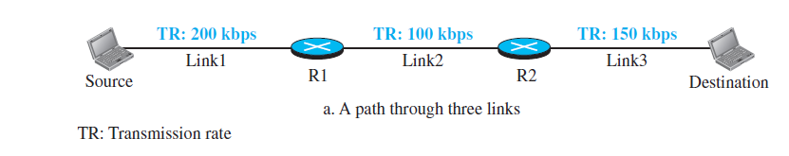
Throughput
Throughput = minimum {TR1, TR2, . . . TRn}.

Slide 14
Packet Loss
When a router receives a packet while processing another packet, the received packet needs to be stored in the input buffer waiting for its turn.
A router, however, has an input buffer with a limited size. A time may come when the buffer is full and the next packet needs to be dropped.
The effect of packet loss on the Internet network layer is that the packet needs to be resent, which in turn may create overflow and cause more packet loss.

